Slide 1
Eclipse Plugin Development
Martin Toshev
Dmitry Alexandrov

Slide 2
Agenda
Brief history and evolution of the platform
OSGi
Eclipse RCP – main components and architecture
Deployment structure and plug-in installation flow
Developing plug-ins
Demos
Q&A

Slide 3
History and evolution of the platform (1)
1998 – OTI (Object Technology International – a subsidiary of IBM purchased in 1996, now known as IBM Ottawa Lab) starts developing what is now known as Eclipse IDE
2001 – Eclipse IDE was outsourced in order to increase adoption and acceleration. The Eclipse consortium and eclipse.org were established (along with 8 other organizations)
2001 – Eclipse 1.0
2002 – Eclipse 2.0
2003 – Eclipse 2.1
2004 – Eclipse Software Foundation was created – on the 21st of June Eclipse 3.0 was shipped (codebase originated from VisualAge) with a runtime architecture following the OSGi Service Platform specification
Notes:
At the time development started IBM was lacking integration between the various development tools – customers started complaining;
‘Eclipse’ means to ‘to eclipse Visual Studio’;
The design of the platform was aimed to be competitive with Visual Studio – this led to the design of SWT (Standard Widget Toolkit) – the UI library used to build the components of the platform
With the establishment of the Eclipse Software foundation (ESF) – IBM continued to contribute significantly (WPT, TPTP)
Eclipse was first released under the CPL (Common Public License) but was later relicensed under the EPL – Eclipse public license – both are incompatible with GPL
2001 – IBM started developing a commercial Eclipse-based platform that is now known as RAD (Rational Application Developer) – current version of RAD is 8.0.4 released in November 2011
The Eclipse platform aims:
To be an open-platform - run on a wide range of operating systems and be used for development of GUI and non-GUI applications
To be language neutral – permit unrestrictive content types and allow for development using different programming languages – HTML, Java, C, JSP, EJB, GIF …
To facilitate seemless tool integration – at UI and deeper, add new tools to existing installed products
Attract community of tool developers – including independent software vendors (ISVs)

Slide 4
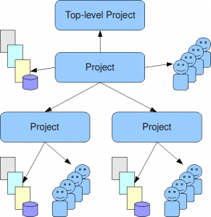
History and evolution of the platform (2)
2004 (21st of June) – 3.0.[1]
2005 (28th of June) – 3.1
2006 (30th of June) – 3.2 (Calisto) – WTP donated from IBM
2007 (29th of June) – 3.3 (Europa)
2008 (25th of June) – 3.4 (Ganymede)
2009 (24th of June) – 3.5 (Galileo)
2010 (23rd of June) – 3.6 (Helios)
2011 (22nd of June) – 3.7 (Indigo)
2012 (27th of June) – 4.2 (Juno). Eclipse 4.2 is the result of the e4 incubation
Notes:
Incubation (regarding e4) – in the Eclipse platform the purpose of the incubation phase is to establish a fully-functional open-source project; some projects might be marked as incubators thus remaining internally in the incubation phase
March, 27th, 2008 – Cisco joins the Eclipse Software Foundation;
E4 aims to:
Simplify the Eclipse programming model (allowing better control and eaiser writing of plugins);
Enable the platform for use on emerging web-based runtime technologies (thus making it more pervasive for web/RIA, desktop, servers, cloud and embedded devices);
Broaden participation in development of the platform.
4) There are 3 main incubator projects that drive innovation and serve as an umbrella for sub-projects (not targeting a particular development phase);
5) Support for Java SE 7 features is added to the Juno release and support for Java SE 8 features is proposed;

Slide 5
History and evolution of the platform (3)
2013 (planned 26 of June) – 4.3 (Kepler)
2014 (planned 25 of June) – 4.4 (Luna)
2012 – started development of Eclipse Orion – open-source browser-based IDE for web development in the cloud
Notes:
Incubation (regarding e4) – in the Eclipse platform the purpose of the incubation phase is to establish a fully-functional open-source project; some projects might be marked as incubators thus remaining internally in the incubation phase
March, 27th, 2008 – Cisco joins the Eclipse Software Foundation;
E4 aims to:
Simplify the Eclipse programming model (allowing better control and eaiser writing of plugins);
Enable the platform for use on emerging web-based runtime technologies (thus making it more pervasive for web/RIA, desktop, servers, cloud and embedded devices);
Broaden participation in development of the platform.
4) There are 3 main incubator projects that drive innovation and serve as an umbrella for sub-projects (not targeting a particular development phase);
5) Juno release is not supported (i.e. tested for Vista) ☺;
6) Support for Java SE 7 features is added to the Juno release and support for Java SE 8 features is proposed;

Slide 6
OSGi (1)
The Open Services Gateway initiative framework is a module system and service platform for the Java programming language that implements a complete and dynamic component model, something that as of 2011 does not exist in standalone Java/VM environments
OSGi allows for applications or components to be installed, started, stopped, updated and uninstalled without requiring a reboot
The OSGi specifications have moved beyond the original focus of service gateways, and are now used in applications ranging from mobile phones to the open source Eclipse IDE. Other application areas include automobiles, industrial automation, building automation, PDAs, grid computing, entertainment, fleet management and application servers
Wikipedia
Notes:
At the time of this presentation current version of OSGi was 4.3 (released October 2011) – version 4.0 was released in October 2005
To clarify – the final version 2.6 version of JSR 291 was released in 2007 and it adds dynamic component model to Java (implementation was finished with Java SE release 7 in 2011)

Slide 7
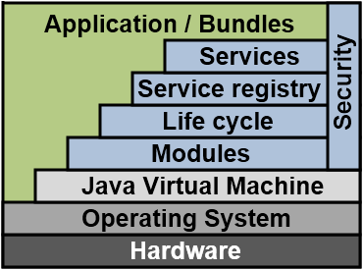
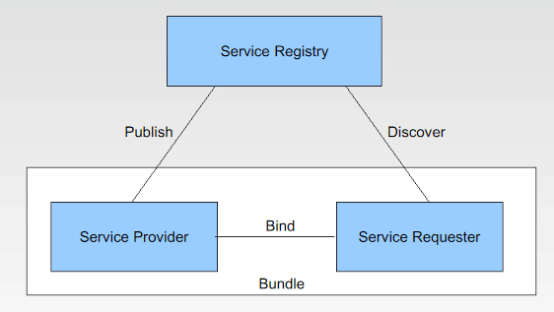
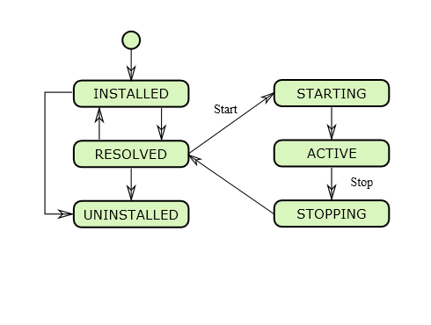
OSGi (2)
Any framework that provides an implementation based on OSGi provides an environment for the modularization of application into smaller bundles – tightly coupled, dynamically loadable collections of classes, jars and configuration files that explicitly declared their dependencies
OSGi logical layers and units:
bundles
services
services registry
life-cycle
modules
security
execution environment

Slide 8
OSGi (3)
Every bundle contains a manifest.mf file (the bundle descriptor) that specifies:
Bundle-Name: Defines a human-readable name for this bundle, Simply assigns a short name to the bundle Bundle-SymbolicName: The only required header, this entry specifies a unique identifier for a bundle, based on the reverse domain name convention (used also by the java packages) Bundle-Description: A description of the bundle's functionality Bundle-ManifestVersion: This little known header indicates the OSGi specification to use for reading this bundle Bundle-Version: Designates a version number to the bundle Bundle-Activator: Indicates the class name to be invoked once a bundle is activated Export-Package: Expresses what Java packages contained in a bundle will be made available to the outside world Import-Package: Indicates what Java packages will be required from the outside world, in order to fulfill the dependencies needed in a bundle.

Slide 9
OSGi (4)
Sample manifest.mf file:
Manifest-Version: 1.0
Bundle-ManifestVersion: 2
Bundle-Name: Sample
Bundle-SymbolicName: com.sample
Bundle-Version: 1.0.0.qualifier
Bundle-Activator: sample.Activator
Bundle-Vendor: test
Require-Bundle: org.eclipse.ui,
org.eclipse.core.runtime
Bundle-RequiredExecutionEnvironment: JavaSE-1.7
Bundle-ActivationPolicy: lazy
Notes:
1) This hiding/exposure of logic requires separate classloader for each bundle.

Slide 10
OSGi (5)
Advantages:
Reduced complexity: changes can be made without affecting other modules
Reuse: easy integration of third party components
Easy deployment – the life-cycle management of components is well-defined
Dynamic updates: Bundles can be installed, started, stopped, updated and uninstalled without bringing down the whole system
Adaptive: The OSGi provides a dynamic service registry where bundles can register, get and listen to services. This dynamic service model allows bundle to find out what all services available in the system and can adapt those functionalities
Transparency: Certain parts of applications can be shutdown for bug fixing
Notes:
You can try the following simple simulation of the equinox osgi runtime:
Navigate to the plugins folder of Eclipse and execute:
java –jar org.eclipse.osgi_XXX.jar –console
2) execute: ss (to view the list of managed bundles) 3) execute:
install file:///<full_path_to_plugins>/org.eclipse.eqinox.p2.core_XXX.jar
4) Try to start it using its id: start <bundle_id> (should fail with missing dependency)
5) execute: ss 6) Install missing dependency and start it
7) execute: ss

Slide 11
Platform - main components
The Eclipse RCP (rich client platform) for developing general purpose applications consists of:
Equinox – a standard bundling framework (OSGi implementation)
Core platform – boot Eclipse, run plug-ins
Standard Widget Toolkit (SWT) – a portable widget toolkit
JFace – viewer classes to bring model view controller programming to SWT, file buffers, text handling, text editors
Eclipse Workbench – views, editors, perspectives, wizards, actions, commands
Notes:
1) As of Eclipse 3.4 M6 (Ganymede) a new provisioning system called p2 is introduced that replaces the old Update Manager

Slide 12
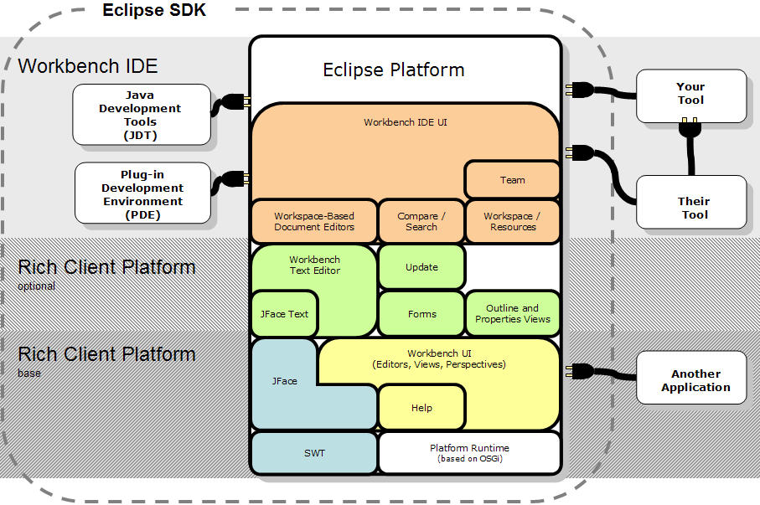
Platform - architecture

Slide 13
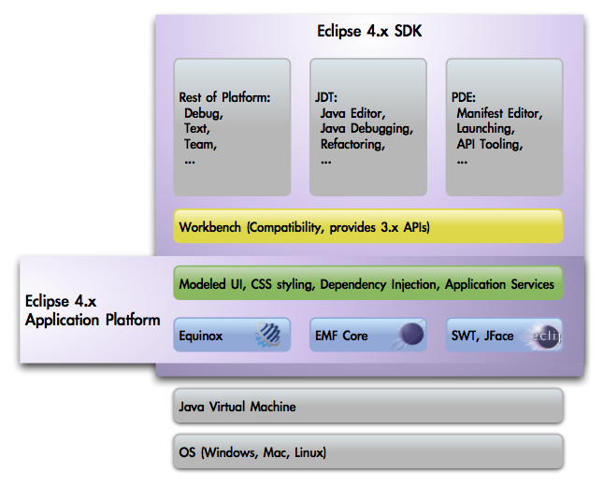
Platform – e4 adoption

Slide 14
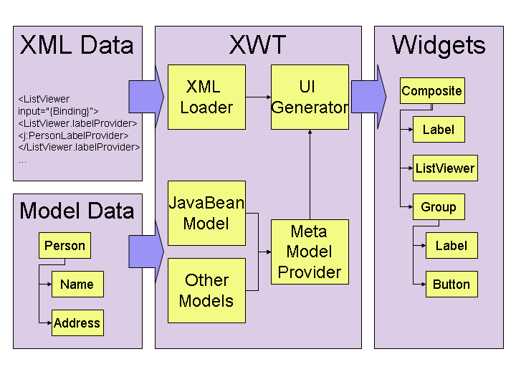
Platform – e4 XWT

Slide 15
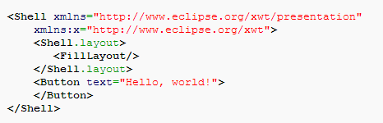

Platform – e4 XWT sample

Slide 16
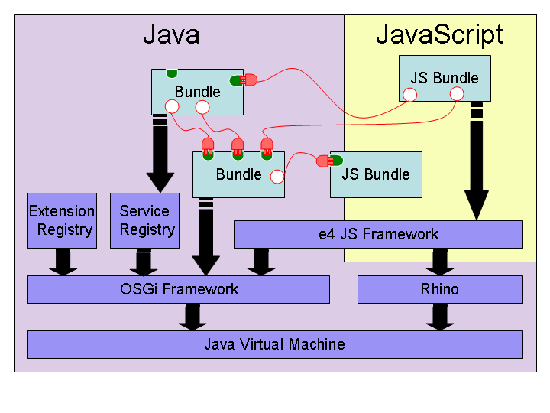
Platform – e4 javascript OSGi support

Slide 17
Deployment structure
eclipse/ main installation folder
configuration/ Eclipse configuration
config.ini main configuration file
org.eclipse.equinox.simpleconfigurator/
bundles.info current set of plugins
dropins/ folder scanned for plugins
features/ features folder
p2/ p2 configuration folder
plugins/ plug-ins folder
eclipse.exe Eclipse loader
eclipse.ini Eclipse configuration file

Slide 18
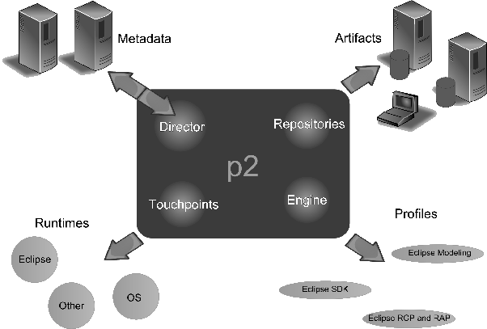
Plug-in installation – p2 overview
Notes:
Equinox p2 is all about installation units (IU). An IU is a description of the name and id of the artifact you are installing. This metadata also describes the capabilities of the artifact (what is provided) and its requirements (its dependencies).
A profile is a list of IUs in your install. For instance, your Eclipse SDK has a profile that describes your current install.

Slide 19
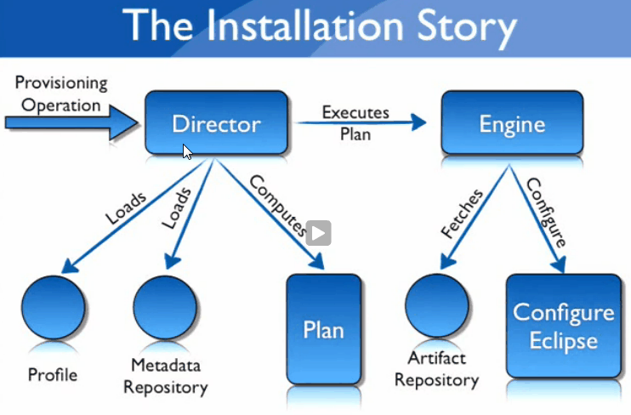
Plug-in installation flow using p2

Slide 20
Plugin development – plug-ins
OSGi bundles
Use extension points
Provide extension points

Slide 21
Plugin development – core components
The Eclipse Platform
Equinox – An OSGi R4 specification implementation used by Eclipse (a common environment for executing plug-ins (bundles) and managing their life-cycle)
Various Eclipse plug-ins – The services managed by Equinox
The Eclipse IDE - ADT, CDT, JDT, PDT and many others

Slide 22
Plugin development – the workbench
Common characteristics of the workbench components:
Created statically via the use of extensions to existing extension points (some can be created dynamically via the source code)
Most of them have a well-defined lifecycle
Most of them are represented by a particular class that must conform to certain rules

Slide 23
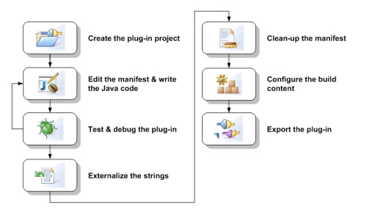
Plugin development – the process

Slide 24
Plugin development – plugin.xml
<?xml version="1.0" encoding="UTF-8"?>
<?eclipse version="3.4"?>
<plugin>
<extension
point="org.eclipse.ui.views">
<category
id=“sample.category"
name=“sample">
</category>
<view
category=“sample.category"
class=“sample"
id=“sample.view"
name=“sample"
restorable="true">
</view>
</extension>
</plugin>

Slide 25
Plugin development – views
(extension point: org.eclipse.ui.views)
Typically used to navigate a hierarchy of information, open an editor or display properties for the active editor
Can be grouped into categories
Can be arranged by a perspective
View classes must implement the IViewPart interface

Slide 26
Plugin development – actions & commands
Used to supply functionality for toolbar buttons, context menu items and top-level menu items
Commands separate presentation from implementation, while actions don’t
Can be enabled/disabled for a perspective or by a custom condition
Action classes must implement the IActionDelegate interface, while command classes must implement the IHandler interface

Slide 27
Plugin development – editors (1)
(extension point: org.eclipse.ui.editors)
Primary mechanism to modify resources – text editors, multipage editors and others
Have an open-modify-save-close lifecycle
Can be stacked
Editors can be:
Text editors.
Form-based editors can layout controls in a fashion similar to a dialog or wizard.
Graphics intensive editors can be written using SWT level code.
List-oriented editors can use JFace list, tree, and table viewers to manipulate their data.

Slide 28
Plugin development – editors (2)
Editor classes must implement the IEditorPart interface or extend EditorPart
Editor input is manipulated by means of the IEditorInput interface
The text editor framework provides a model-independent editor that supports the following features:
presentation and user modification of text
standard text editing operations such as cut/copy/paste, find/replace
support for context and pulldown menus
visual presentation of text annotations in rulers or as squigglies in the text
automatic update of annotations as the user edits text
presentation of additional information such as line numbers
syntax highlighting
content assist
text outlining pages that show the hierarchical structure of the text
context sensitive behavior
hover support over rulers and text
key binding contexts
preference handling
Notes:
An editor must implement IEditorPart and is often built by extending the EditorPart class. An editor implements its user interface in the createPartControl method. This method is used to assemble the SWT widgets or JFace viewers that present the editor contents.
An editor input is a description of something to be edited. You can think of an editor input as a file name, though it is more general. IEditorInput defines the protocol for an editor input, including the name of the input and the image that should be used to represent it in the labels at the top of the editor.
Three generic editor inputs are provided in the platform. IFileEditorInput represents an input that is a file in the file system, and IURIEditorInput represents an input based on a URI. IStorageEditorInput represents an input that is a stream of bytes. These bytes may come from sources other than the file system.

Slide 29
Plugin development – editors (3)
A custom text editor can be created by extending AbstractTextEditor or TextEditor
For source code style editors, a SourceViewer is provided. It can be customized by extending SourceViewerConfiguration.
Operations on text resources:
Partitioning & Syntax highlighting
Scanner
Rules
IPredicateRule
IRule
Detectors
Formatting
Completion
Notes:
The platform text facility is used to implement the default text editor for the workbench. The interface for text editing is defined in ITextEditor as a text specific extension of IEditorPart.
The implementation of ITextEditor in the platform is structured in layers. AbstractTextEditor is the core class of the framework for extending the editor to support source code style editing of text. This framework is defined in org.eclipse.ui.texteditor.
The concrete implementation class TextEditor defines the behavior for the standard platform text editor. It is defined in the package org.eclipse.ui.editors.text.

Slide 30
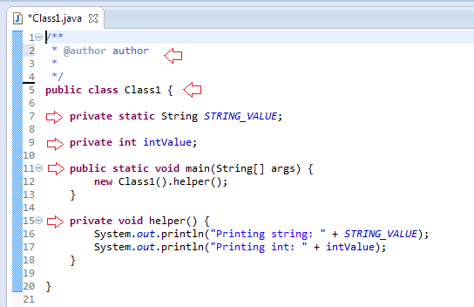
Plugin development – editors (5)
Working with text resources – document structure:
Partitioning
IPredicateRule
Notes:
The partitioner (IDocumentPartitioner) is responsible for dividing the document into non-overlapping regions called partitions. Partitions (represented by ITypedRegion) are useful for treating different sections of the document differently with respect to features like syntax highlighting or formatting.
It is up to each editor to determine the appropriate implementation for a document partitioner. Support is provided in org.eclipse.jface.text.rules for rule-based document scanning. Using a rule-based scanner allows an editor to use the FastPartitioner provided by the framework.
RuleBasedPartitionScanner is the superclass for rule based scanners. Subclasses are responsible for enumerating and implementing the rules that should be used to distinguish tokens such as line delimiters, white space, and generic patterns when scanning a document.

Slide 31
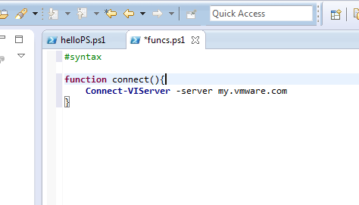
Plugin development – editors (6)
Working with text resources - highlighting:
Damage, repair, and reconciling (IPresentationDamager, IPresentationRepairer, IPresentationReconciler)
Scanner
Detectors
Rules
IRule
Notes:
Damage, repair, and reconciling
As the user modifies text in an editor, parts of the editor must be redisplayed to show the changes. Computing the text that must be redisplayed is known as computing damage. When syntax coloring is involved, the amount of damage caused by an editing operation becomes more extensive, since the presence or absence of a single character could change the coloring of the text around it.
Damagers (IPresentationDamager) determine the region of a document's presentation which must be rebuilt because of a document change. A presentation damager is assumed to be specific to a particular document content type (or region). It must be able to return a damage region that is valid input for a presentation repairer (IPresentationRepairer). A repairer must be able to derive all of the information it needs from a damage region in order to successfully describe the repairs that are needed for a particular content type.
Reconciling describes the overall process of maintaining the presentation of a document as changes are made in the editor. A presentation reconciler (IPresentationReconciler) monitors changes to the text through its associated viewer. It uses the document's regions to determine the content types affected by the change and notifies a damager that is appropriate for the affected content type. Once the damage is computed, it is passed to the appropriate repairer which will construct repair descriptions that are applied to the viewer to put it back in sync with the underlying content.
Predicate
Defines the interface for a rule used in the scanning of text for the purpose of document partitioning or text styling. A predicate rule can only return one single token after having successfully detected content. This token is called success token. Also, it also returns a token indicating that this rule has not been successful.

Slide 32
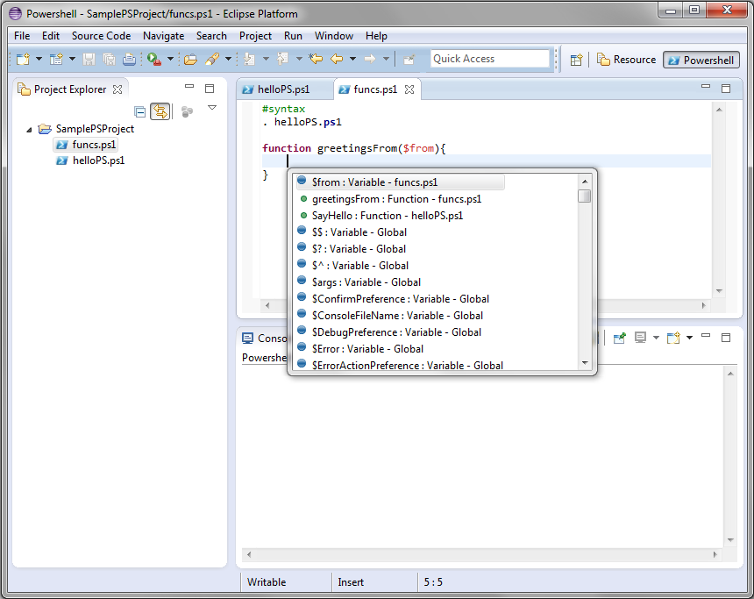
Plugin development – editors (4)
Working with text resources – content assist:
IContentAssistant
IContentAssistProcessor
Notes:
Content assist behavior is defined in the interface IContentAssistant.
Setting up a content assistant is somewhat similar to setting up syntax highlighting. The assistant should be configured with different phrase completion strategies for different document content types. The completion strategies are implemented using IContentAssistProcessor. A processor proposes completions and computes context information for an offset within particular content type.

Slide 33
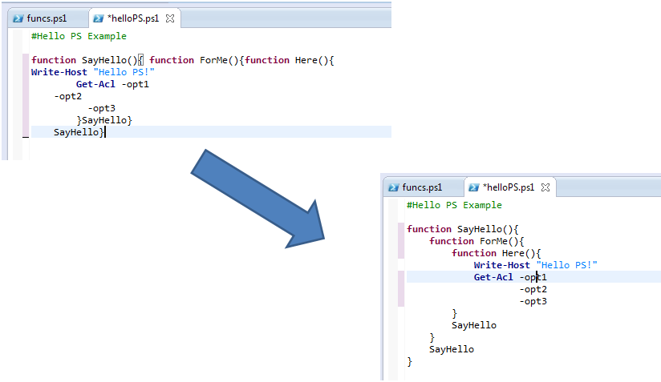
Plugin development – editors (7)
Working with text resources – document readability:
IFormattingStrategy

Slide 34
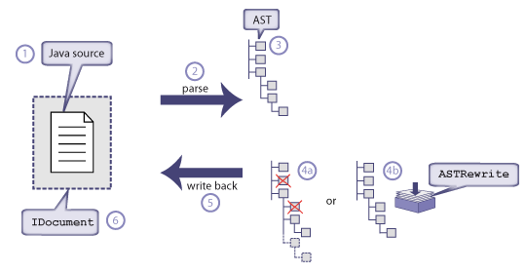
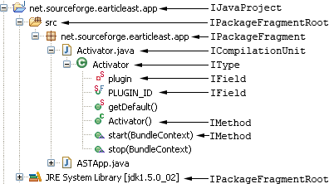
Plugin development – the AST

Slide 35
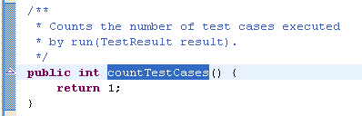
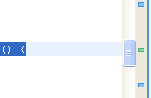
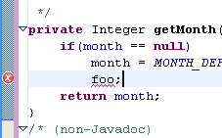
Plugin development – editors (8)
Vertical ruler
Overview ruler
Text annotations
Working with text resources – Annotations and rulers:
<extension
point="org.eclipse.core.filebuffers.annotationModelCreation">
<factory extensions="*" class="org.eclipse.ui.texteditor.ResourceMarkerAnnotationModelFactory">
</factory>
</extension>
Notes:
Vertical ruler
A vertical ruler to the left of the editing area is used by platform text editors to show text ranges and line-based annotations adjacent to their text line.
Overview ruler
An overview ruler on the right hand side of the editing area is used to show annotations concerning the entire document. These annotations are shown relative to their position in the document and do not move as the user scrolls the document. There usually is a corresponding annotation on the vertical ruler when that portion of the document is visible.
Text annotations
In addition to showing annotations in the rulers, a source viewer can show annotations as colored squiggly marks in the text.

Slide 36
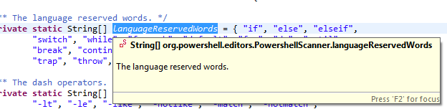

Plugin development – editors (9)
Text hover
Ruler hover
Working with text resources – Hover information:
Notes:
Text hover
Text hover allows you to provide informational text about text shown in the editor. This is done using the ITextHover interface. A text hover is responsible for computing the region that should be used as the source of hover information, given an offset into the document. It is also responsible for providing the informational text about a specific region. JavaTextHover is pretty simple. It checks to see if the supplied offset for hover is contained inside the text selection. If so, it supplies the selection range as hover region.
Ruler hover
Hover on the vertical ruler is useful for showing show line-oriented information. The hover class is configured as described above. IAnnotationHover is the interface for ruler hover objects. Although the name implies that the hover is designed for annotations in the ruler, it is really up to an individual editor to detemine what is appropriate. A ruler hover is responsible for returning the info string associated with a particular line number, regardless of the presence of markers on that line.

Slide 37
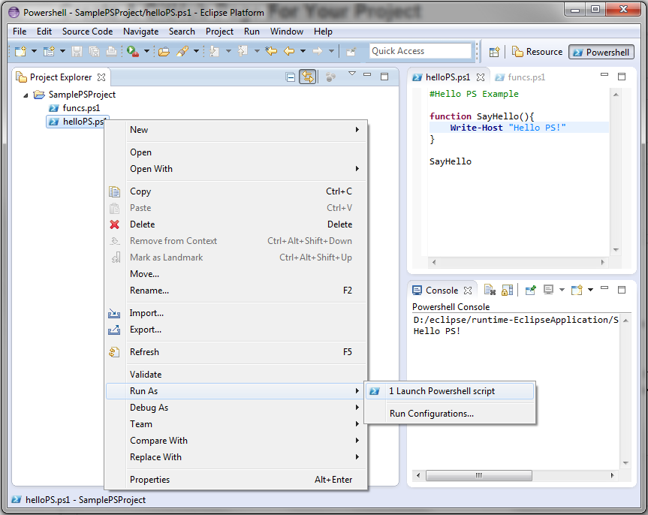
Plugin development – launching & console view
IDE sugar
- Launch functionality
- Delegate
- Shortcut
- LaunchConfiguration
Console
- Work with MessageConsole

Slide 38
Plugin development – perspectives
(extension point: org.eclipse.ui.perspectives)
Used for organizing/arranging views, editors and commands in the workbench
Already existing perspectives can be enhanced as well
Perspectives classes must implement the IPerspectiveFactory interface

Slide 39
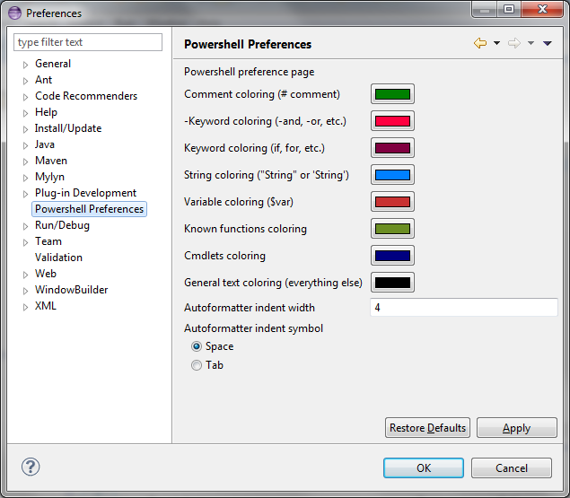
Plugin development – other extensions
Preferences (org.eclipse.ui.preferencePages)
Properties (org.eclipse.ui.propertyPages)
Help pages (org.eclipse.ui.help)

Slide 40
Plugin development – EFS
In the EFS (Eclipse file system) all resources implement the IResource interface:
files (IFile resources)
folders (IFolder resources)
projects (IProject resources)
the workspace root (IWorkspaceRoot resource)
Notes:
In Eclipse 3.2, the way that resources were referenced from disk changed markedly. Ever since its inception as an IDE back in Eclipse 1.0, the way that files are referenced was via a handle called IResource. In fact, IResources, along with the basic subtypes IProject, IFolder and IFile, go to make up the majority of resource-based access inside Eclipse actions, even to this day.
The IResource handle contains meta-data such as the name, time last modified, as well as markers (used to show compile errors and other messages in particular files). Note that IResources are used when caching some elements of the file system; the refresh command in Eclipse synchronises the meta-data contents of the file system with the internal cache of the resource tree. Previously, access was fundamentally file-based; for example, all IResources have the method getLocation(), which was previously expected to be an IPath that points to a full file on disk (and indeed, often used via the .toFile() method to convert it to a java.io.File object). Although this level of abstraction works well for file-based systems, it doesn't translate very well when the data is stored elsewhere (such as on a remote webserver via WebDAV or in an SQL database).
As a result, EFS was created to provide an abstraction of generic file systems by using URIs to represent resources on those file systems, and IResource was updated to include a getLocationURI(). Instead of having to rely on a specific file system (or assume that your operating system will mount it properly), you can supply an EFS implementation and then configure Eclipse to use that for storing data. (There's even a file: EFS implementation, which uses the local file system via java.io.File objects, as well as a null: EFS implementation that does nothing.)

Slide 41
Plugin development – EFS

Slide 42
Plugin development – resource change tracking
IResourceChangeListener
IResourceDeltaVisitor
The resource delta is structured as a tree rooted at the workspace root
Resources that have been created, deleted, or changed. If you have deleted (or added) a folder, the resource delta will include the folder and all files contained in the folder
Resources that have been moved or renamed using the IResource.move() API
Markers that have been added, removed, or changed. Marker modification is considered to be a workspace modification operation
Files that have been modified. Changed files are identified in the resource delta, but you do not have access to the previous content of the file in the resource delta
ResourcesPlugin.getWorkspace().addResourceChangeListener(
listener, IResourceChangeEvent.POST_CHANGE);
Notes:
The central hub for your user's data files is called a workspace. The workspace contains a collection of resources. From the user's perspective, there are three different types of resources: projects, folders, and files.
When the platform is running and the resources plug-in is active, the workspace is represented by an instance of IWorkspace
In the course of performing its function, your plug-in may need to make changes to resources in the workspace. The workspace is an important data model for many plug-ins in the system, many of which rely on keeping up with the current state of the workspace. Plug-ins may even be concurrently updating the workspace. It's important for your plug-in to act as a responsible workspace citizen when making changes to resources. What makes a plug-in a good workspace citizen?
Batching of changes where possible to avoid flooding the system with unnecessary events or triggering unnecessary processing on an interim state.
Listening to resource change events and updating models as the workspace changes.
Fine-grained locking of the workspace when making modifications instead of locking the entire workspace.
To traverse a resource delta tree, you may implement the IResourceDeltaVisitor interface or traverse the tree explicitly using IResource.getAffectedChildren. Resource delta visitors implement a visit method that is called by the resource delta as it enumerates each change in the tree.
Note: Changes made to resource session properties or resource persistent properties are not identified in the resource delta.

Slide 43
Plugin development – services
The workbench defines a number of services that can be retrieved from the org.eclipse.ui.services.IServiceLocator:
Service | Description | Availability
IBindingService | Provides services related to the binding architecture (e.g., keyboard shortcuts) within the workbench. | Globally
ICommandService | Provides services related to the command architecture within the workbench. | Globally
ICommandImageService | Provides a look-up facility for images associated with commands. | Globally
IContextService | Provides services related to contexts in the Eclipse workbench, like context activation and definitions. | Globally
IContributionService | Standard mechanisms that clients may use to order, display, and generally work with contributions to the Workbench. | Globally
IEvaluationService | Evaluate a core expression against the workbench application context and report updates using a Boolean property. | Globally
IFocusService | Tracks focusGained and focusLost events. | Globally
IHandlerService | Provides services related to activating and deactivating handlers within the workbench. | Globally
IMenuService | Provides services related to the menu architecture within the workbench. | Globally
IPageService | A page service tracks the page and perspective lifecycle events within a workbench window. | Workbench Window
IPartService | A part service tracks the creation and activation of parts within a workbench window. | Workbench Window
IProgressService | The progress service is the primary interface to the workbench progress support. | Globally
IWorkbenchSiteProgressService | The part progress service is an IProgressService that adds API for jobs that change the state in a IWorkbenchPartSite while they are being run. | Part Site
ISaveablesLifecycleListener | Listener for events fired by implementers of ISaveablesSource. | Globally
ISelectionService | A selection service tracks the selection within an a workbench window. | Workbench Window
Notes:
1)

Slide 44
Plugin development – the selection service
getSite().getWorkbenchWindow()
.getSelectionService().addSelectionListener(<listener>);
// <listener> must implement ISelectionListener
getSite().setSelectionProvider(<provider>);
// <provider> must implement ISelectionProvider)
Notes:
1)

Slide 45
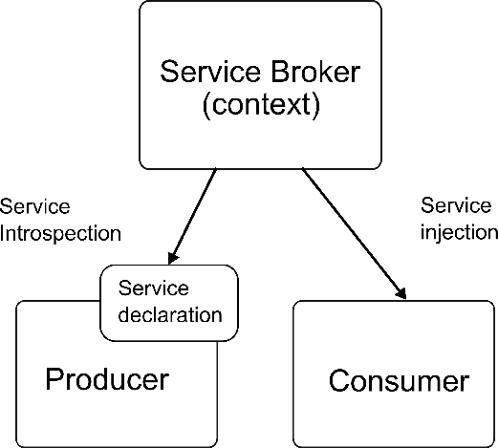
Plugin development – e4 service overview
Notes:
1)

Slide 46
Plugin development – packaging
Plug-in – an OSGi bundle
Feature – grouping of plug-ins and fragments
Fragment – extend the functionality of another plug-in
Update site – grouping of features that can be installed from a site
Notes:
1)

Slide 47
Plugin development – IDE inspection
The plug-in selection spy (Alt + Shift + F1) / menu spy (Alt + Shift + F2)
Import plug-ins / fragment from the Import Wizard
Window -> Preferences -> Plug-in Development -> Include all plug-ins from target in Java search
Eclipse Git repo
Plug-in Registry/Plug-ins/Plug-in Dependencies
Notes:
1)

Slide 48
Further topics
Implementing help – providing useful information for a plug-in
Internationalization – expanding the scope of our plug-in
Building a plug-in – creating an Ant/Maven - based build script for a plug-in
Publishing a plug-in – creating an update site for a plug-in
SWT and JFace
GEF and GMF
Comparison with another platforms in terms of plug-in development
Overview of existing plug-ins and features
Providing extension points for a plug-in

Slide 49
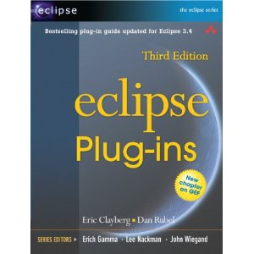
Recommended readings
Eclipse Plug-ins (3rd edition) – Eric Clayberg, Dan Rubel
Eclipse corner articles (http://www.eclipse.org/articles/)

Slide 50
Q & A
Thank you

Slide 51
Additional references (1)
Brief history of Eclipse (up to 2006) http://www.venukb.com/2006/07/21/history-of-eclipse/ last visited: 01.03.2013
Wikipedia’s entry on Eclipse http://en.wikipedia.org/wiki/Eclipse_(software) last visited: 01.03.2013
eclipse.org: Eclipse e4 http://eclipse.org/e4/ last visited: 01.03.2013
EclipseCon 2009: e4 Project in Review http://live.eclipse.org/node/737 last visited: 01.03.2013

Slide 52
Additional references (2)
eclipse.org: Eclipse development process http://www.eclipse.org/eclipse/development/ last visited: 01.03.2013
Eclipse wiki: Development Resources http://wiki.eclipse.org/Development_Resources last visited: 01.03.2013
Eclipse wiki: http://wiki.eclipse.org/Development_Resources/Process_Guidelines/What_is_Incubation last visited: 01.03.2013

Slide 53
Additional references (3)
Architecture of the Eclipse platform https://wiki.engr.illinois.edu/download/attachments/183861826/cs427-12.pdf?version=1&modificationDate=1317337982000 last visited: 01.03.2013
vogella.de: Extending Eclipse –Plug-in Development Tutorial http://www.vogella.de/articles/EclipsePlugIn/article.html last visited: 01.03.2013
OSGi tutorial http://www.knopflerfish.org/tutorials/osgi_tutorial.pdf last visited: 01.03.2013
vogella.de: OSGi with Eclipse Equinox http://www.vogella.de/articles/OSGi/article.html last visited: 01.03.2013

Slide 54
Additional references (4)
Wikipedia entry on OSGi http://en.wikipedia.org/wiki/OSGi last visited: 01.03.2013
Wikipedia entry of Equinox http://en.wikipedia.org/wiki/Equinox_(OSGi) last visited: 01.03.2013
Understanding the Eclipse p2 provisioning system http://eclipse.dzone.com/articles/understanding-eclipse-p2-provi last visited 01.03.2013
Introduction to p2 (video) http://www.fosslc.org/drupal/content/gentle-introduction-p2 last visited: 01.03.2013

Slide 55
Additional references (5)
eclipse.org: project plan for Eclipse project, version Juno http://www.eclipse.org/projects/project-plan.php?planurl=http://www.eclipse.org/eclipse/development/plans/eclipse_project_plan_4_2.xml last visited: 01.03.2013
The architecture of open source applications (chapter 6: Eclipse) http://www.aosabook.org/en/eclipse.html last visited: 01.03.2013
Eclipse Plug-in developers guide – Editor http://help.eclipse.org/juno/index.jsp?topic=%2Forg.eclipse.platform.doc.isv%2Fguide%2Feditors.htm&cp=2_0_13
last visited: 01.03.2013

